Slide 1
Design

Slide 2
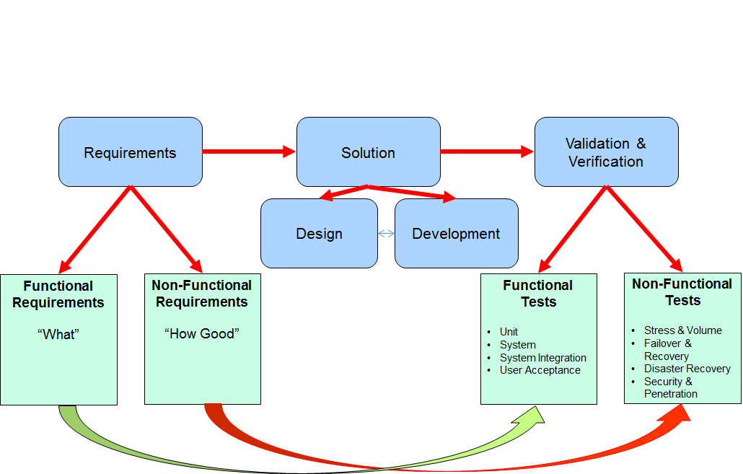
Design : Where does it Fit?*
*This picture does not resemble any development life cycle
Notes:
test

Slide 3
Design : Definition
The design of a system outlines what the system is for and not for, describes the overall architecture following which the system will be developed and details its static structure and dynamic behaviour.
Design has two parts
  Functional Design
    Concentrates on the functionality of the system
  Operational Design
    Concentrates on the operational aspects like hardware setup, which functionality runs where, network design etc.
Notes:
test

Slide 4
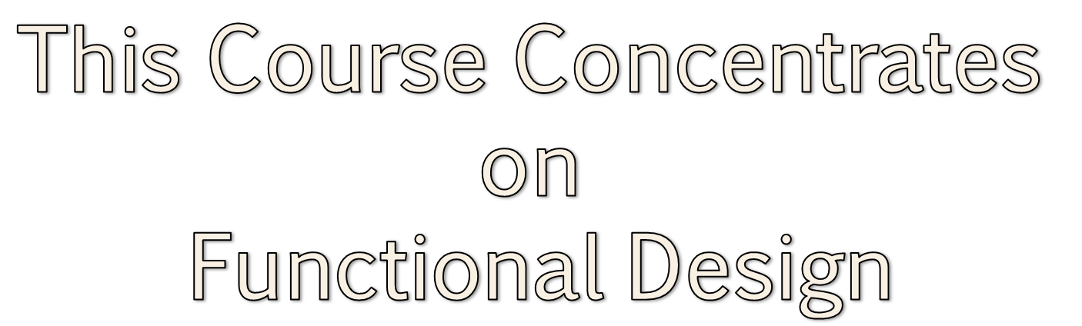
Design : Definition
The design of a system outlines what the system is for and not for, describes the overall architecture following which the system will be developed and details its static structure and dynamic behaviour.
Notes:
test

Slide 5

Design : Thoughts behind a Good Design*
Should think about users, coders and maintainers
Should consider alternate approaches
Should not reinvent the wheel
  Use established patterns
Should be structured to accommodate changes
Should trace back to requirements
Notes:
test

Slide 6
Design : Qualities of a Good Design
Extensibility
Modularity
Reusability
Maintainability
Usability
Clarity
...
Notes:
test

Slide 7
Design : A Three Step Process
Define system boundary
Create structure of the solution
Refine the structure to implement the solution
Architecture
Notes:
test

Slide 8
Design : A Three Step Process
Define system boundary
  What is the purpose of the system?
  What the system does not do
  What are the external dependencies?
Create structure of the solution
Refine the structure to implement the solution
Notes:
test

Slide 9
Design : A Three Step Process
Define system boundary
Create structure of the solution
  How the system will be accessed?
  What are the main conceptual elements?
  How the elements communicate with each other?
Refine the structure to implement the solution
Notes:
test

Slide 10
Design : A Three Step Process
Define system boundary
Create structure of the solution
Refine the structure to implement the solution
  How can the conceptual elements be subdivided into subsystems?
  How do the subsystems look like?
  How do the subsystems interact with each other functionally?
Notes:
test

Slide 11
Design: Representation
Design is represented through various models
Effective model helps to
  Understand the system we are building
  Communicate the desired structure and behaviour of a system
  Visualize and control the system architecture
  Expose opportunities for simplification and reuse
  Manage Risk
Notes:
test

Slide 12
Design : Principles of Modeling
Choose the models well
  Right models brilliantly illuminate wicked development problems
  Wrong models mislead and causes to focus on irrelevant issues
  The choice of models has influence on
    How a problem is attacked
    How a solution is shaped
Notes:
test

Slide 13
Design : Principles of Modeling
Every model may be expressed at different levels of precision
  Best models let us choose the degree of details depending on
    Who is viewing it
    Why they need to view it
The best models are connected to reality
  Simplify reality
  Be sure that simplification do not mask any important details
Notes:
test

Slide 14
Design : Principles of Modeling
No single model is sufficient
  We need several complementary and interlocking views e.g. design view, process view
  All models together represent the nature of the system
  Depending on the nature of system some models may be more important than others
Notes:
test

Slide 15
Design :Decision
During design, several decisions are taken
It is important to document design decisions.
Typical contents
  Decision Name
  Why this decision was needed
  What were the alternatives
  What was the decision
  What is the rationale
Notes:
test

Slide 16
Design : Decision Template
Subject Area | Area of concern | Topic | Topic of interest
Design Decision | Summary of the decision made, write as a statement indicating what the decision is e.g. “Develop web app for online voting from mobiles so that there is no dependency on native OS”. | ID | A unique identifier
Issue or Problem Statement | A short description of the problem - what is being decided.
Assumptions | What is believed to be true about the context of the problem
Motivation | Why this decision is important?
Alternatives | A list of alternatives and explanations.
Decision | The decision taken, possibly with references to related work products.
Justification | Why the decision was made
Implications | What impact the decision will have.
Derived requirements | A list of requirements that are generated by this decision.
Related Decisions | A list of related decisions
Notes:
test

